Slide 1
BITS Pilani
Dr. Lavika Goel
Assistant Professor
Department of CSIS
Lecture 1: 12/1/2019
Pilani Campus

Slide 2
Pilani Campus
Information Retrieval (SS ZG537)
1/11/2019 SS ZG537 (INFORMATION RETRIEVAL) 2

Slide 3

Today’s Agenda
General course information & objectives
Reasons to take this course
Course Logistics & Course Outline
Introduction to Information Retrieval
Boolean Retrieval Model
Inverted Index
Boolean query processing
Merge algorithm
1/11/2019 SS ZG537 (INFORMATION RETRIEVAL) 3
Pilani Campus

Slide 4
General Course Information
Instructor: Dr. Lavika Goel
Office: 6120-J
Email: lavika.goel@pilani.bits-pilani.ac.in
1/11/2019 SS ZG537 (INFORMATION RETRIEVAL) 4
Pilani Campus

Slide 5
Objectives
Introduce the field of Information Retrieval (IR).
Basic foundation, Principles, Methods etc.
Trends: Frontier Topics
Prepare you to take up challenges in IR or related fields.
1/11/2019 SS ZG537 (INFORMATION RETRIEVAL) 5
Pilani Campus

Slide 6
Reasons to take this course
Information changes people’s life.
Users need to find useful information: Very HUGE amount of data.
Industries need to earn money through search engines: Google, Yahoo, Bing, Baidu, SoSo, Sogou, etc.
Many interesting problems in IR field haven’t been solved.
1/11/2019 SS ZG537 (INFORMATION RETRIEVAL) 6
Pilani Campus

Slide 7
Course Logistics
1/11/2019 SS ZG537 (INFORMATION RETRIEVAL) 7
Pilani Campus

Slide 8
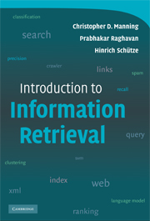
Text Book
1/11/2019 SS ZG537 (INFORMATION RETRIEVAL) 8
Pilani Campus

Slide 9
Reference Books
R1 | Modern Information Retrieval, Ricardo Baeza-Yates and Berthier Ribeiro-Neto, Addison-Wesley, 2000. http://people.ischool.berkeley.edu/~hearst/irbook/
R2 | Search Engines: Information Retrieval in Practice by Bruce Croft, Donald Metzler, and Trevor Strohman, Addison-Wesley, 2009.
R3 | Cross-Language Information Retrieval by By Jian-Yun Nie Morgan & Claypool Publisher series 2010.
R4 | Multimedia Information Retrieval by Stefan M. Rüger Morgan & Claypool Publisher series 2010.
R5 | Information Retrieval: Implementing and Evaluating Search Engines by S. Buttcher, C. Clarke and G. Cormack, MIT Press, 2010.
R6 | Web Data Mining: Exploring Hyperlinks, Contents, and Usage Data by B. Liu, Springer, Second Edition, 2011.
R7 | Ricci, F.; Rokach, L.; Shapira, B.; Kantor, P.B. (Eds.), Recommender Systems Handbook. 1st Edition., 2011, 845 p. 20 illus., Hardcover, ISBN: 978-0-387-85819-7
R8 | Koehn P., “Statistical Machine Translation”, Cambridge University Press, 2010.
1/11/2019 SS ZG537 (INFORMATION RETRIEVAL) 9

Slide 10
Course Outline
Overview of IR
Text and vector space classification
Cross Language Information Retrieval(CLIR)
Multimedia Information retrieval(MIR)
Recommender Systems
Web search
1/11/2019 SS ZG537 (INFORMATION RETRIEVAL) 10
Pilani Campus

Slide 11
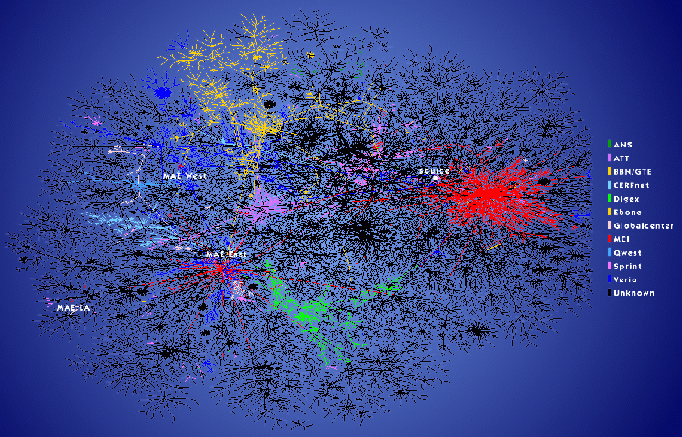
The Internet is enormous
http://www.nature.com/nature/webmatters/tomog/tomfigs/fig1.htm
Prototype two-dimensional image depicting global connectivity among ISPs as viewed from skitter host.
1/11/2019 SS ZG537 (INFORMATION RETRIEVAL) 11
Pilani Campus

Slide 12
Why IR?
Web Sites Increasing Sharply
Internet Users Increasing Continuously
Current Web (1 billion users more than 1000 billion pages)
Google
3 billion documents indexed
10-20 TB of text on web
~ 1000 TB of information produced every year
1/11/2019 SS ZG537 (INFORMATION RETRIEVAL) 12
Pilani Campus

Slide 13
How big Facebook’s data?
2.5 billion content items shared per day (status updates + wall posts + photos + videos + comments)
2.7 billion Likes per day, 300 million photos uploaded per day
100+ petabytes of disk space in one of FB’s largest Hadoop (HDFS) clusters
105 terabytes of data scanned via Hive, every 30 minutes
70,000 queries executed on these databases per day
500+terabytes of new data ingested into the databases every day
1/11/2019 SS ZG537 (INFORMATION RETRIEVAL) 13
Pilani Campus

Slide 14
Keywords in IR
A large repository of documents are stored on computers. (Corpus).
There is topic about which I desire to get information (Information need).
Some of the documents may contain the information that satisfies my need (Relevance).
How do I retrieve these documents?
I communicate my information need in the form of a query.
1/11/2019 SS ZG537 (INFORMATION RETRIEVAL) 14
Pilani Campus

Slide 15
Structured data
How the query is expressed will depend on whether the data in the document corpus is structures / unstructured.
Structured data tends to refer to information in “tables” and has a clear, overt semantic structure.
Employee | Manager | Salary
Smith | Jones | 50000000
Chang | Smith | 60000
Ivy | Smith | 50000
1/11/2019 SS ZG537 (INFORMATION RETRIEVAL) 15
Pilani Campus

Slide 16
Structured data
Structured data allows for expressive queries like:
Give me the social security numbers of all the employees who have stayed with company for more than 5 years, and whose yearly salaries are three standard deviations above average salary.
Employee | Manager | Salary
Smith | Jones | 50000000
Chang | Smith | 60000
Ivy | Smith | 50000
Database Systems
1/11/2019 SS ZG537 (INFORMATION RETRIEVAL) 16
Pilani Campus

Slide 17
Unstructured
Unstructured data does not have clear, overt semantic structure(e.g, free text on a web page, audio, video).
Allows less expressive queries of the form:
Give me all documents that have keywords ‘These Romans are crazy’.
Structured data
Database systems
Unstructured data
Information retrieval
1/11/2019 SS ZG537 (INFORMATION RETRIEVAL) 17
Pilani Campus

Slide 18
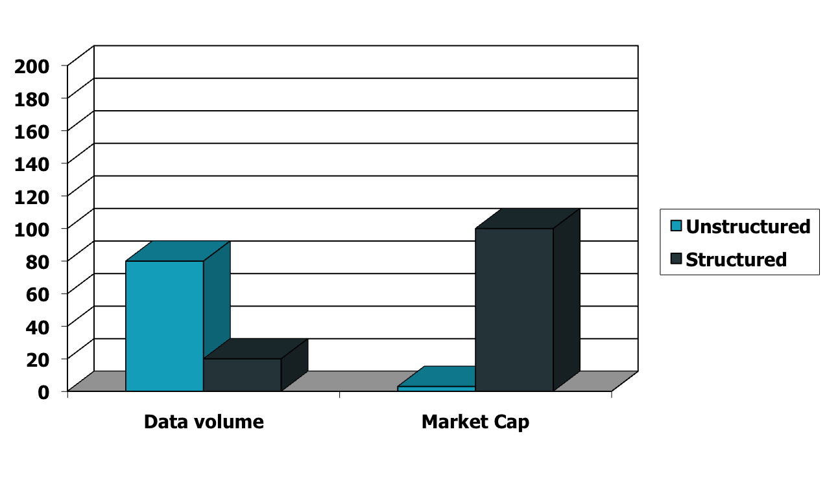
Unstructured (text) vs. structured (database) data in 1996
1/11/2019 SS ZG537 (INFORMATION RETRIEVAL) 18
Pilani Campus

Slide 19




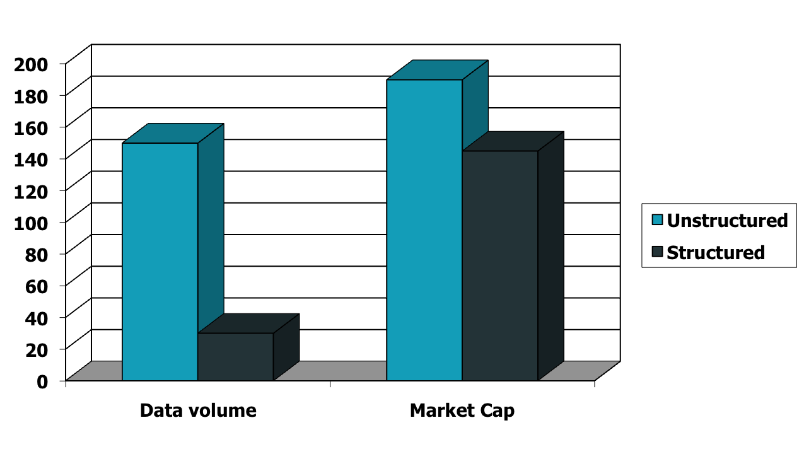
Unstructured (text) vs. structured (database) data in 2009
1/11/2019 SS ZG537 (INFORMATION RETRIEVAL) 19
Pilani Campus

Slide 20
Information Retrieval
Information Retrieval (IR) is finding material (usually documents) of an unstructured nature (usually text) that satisfies an information need.
1/11/2019 SS ZG537 (INFORMATION RETRIEVAL) 20
Pilani Campus

Slide 21
The problem of IR
Goal = find documents relevant to an information need from a large document set
Info. need
Query
Document
collection
IR system
Retrieval
Answer list
1/11/2019 SS ZG537 (INFORMATION RETRIEVAL) 21
Pilani Campus

Slide 22
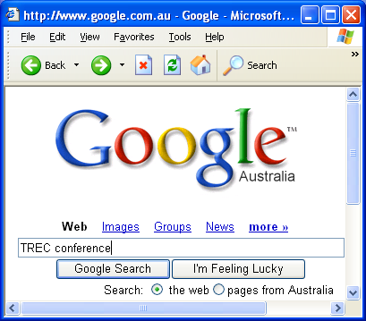
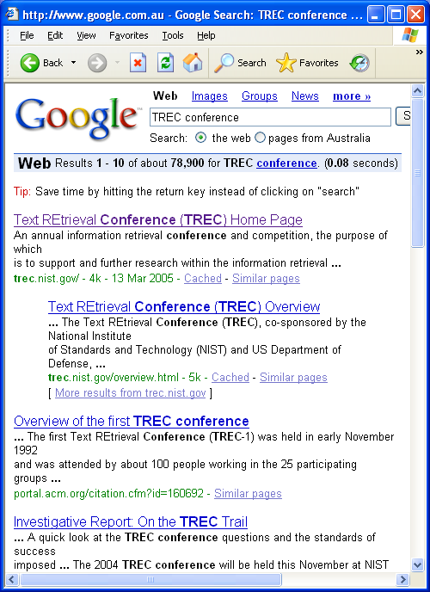
Example
Google
Web
1/11/2019 SS ZG537 (INFORMATION RETRIEVAL) 22
Pilani Campus

Slide 23
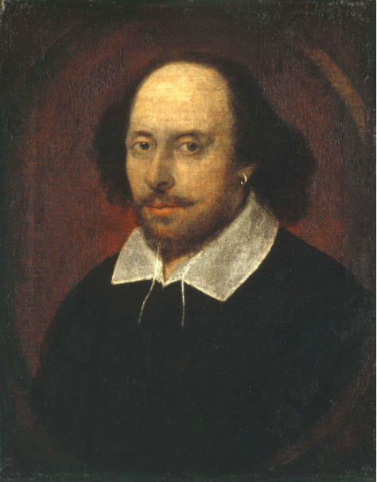
An example IR problem
Document corpus = Shakespeare’s written plays(37).
Information needed = Which plays of Shakespeare contain the words BRUTUS AND CEASAR but NOT CALPURNIA.
1/11/2019 SS ZG537 (INFORMATION RETRIEVAL) 23
Pilani Campus

Slide 24
Naïve solution
Linear scan through all the plays of Shakespeare (‘grepping’)
Need to repeat this for every query.
Works for Shakespeare’s plays, but may not work on huge documents collections (billions / trillions of words)
Can we cut down the time?
Better solution: Preprocess the Corpus in advance and organize the information about the occurrence of different words in a way that speeds up query processing.
1/11/2019 SS ZG537 (INFORMATION RETRIEVAL) 24
Pilani Campus

Slide 25
Term-document incidence
Brutus AND Caesar BUT NOT Calpurnia
1 if play contains word, 0 otherwise
1/11/2019 SS ZG537 (INFORMATION RETRIEVAL) 25
Pilani Campus

Slide 26
Incidence vectors
So we have a 0/1 vector for each term
To answer query: Brutus, Caesar and NOT Calpurnia take the vectors for
Brutus 110100
Caesar 110111
Calpurnia (complemented) 101111
Bitwise AND
110100 AND 110111 AND 101111 = 100100
1/11/2019 SS ZG537 (INFORMATION RETRIEVAL) 26
Pilani Campus

Slide 27
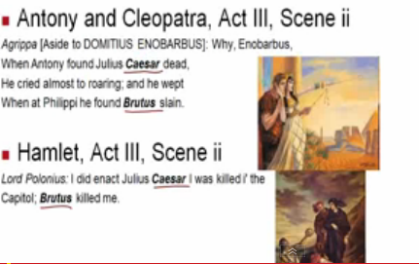
Answers to query
http://www.rhymezone.com/shakespeare/
1/11/2019 SS ZG537 (INFORMATION RETRIEVAL) 27
Pilani Campus

Slide 28
Realistic Scenario
Consider N = 1 million documents, each with about 1000 words.
Each word Avg 6 bytes/ word including spaces/punctuation
6GB of data in the documents.
No of distinct terms ~ 5,00,000
I Million columns
5,00,000
Distinct
words
1/11/2019 SS ZG537 (INFORMATION RETRIEVAL) 28
Pilani Campus

Slide 29
A realistic scenario
No of cells in the term document matrix = 500000x10⁶ = 0.5x10¹² = 0.5 trillion (too much for memory)
If we want to store 0.5 trillion cells in memory how much memory do you need?
If each cell takes 1 byte then we need 0.5x10¹² bytes (i.e 500 GB)in main memory (No common PC in market have this big RAM size)
If each cell takes 1 Bit then we need 500GB/8 still not feasible.
Run out of space for 1 million news documents.
1/11/2019 SS ZG537 (INFORMATION RETRIEVAL) 29
Pilani Campus

Slide 30
Term-document matrix is sparse
Max % of 1’s possible in a
column vector
= (1000/500000)*100
= 10⁵/500000
= 1/5 = 0.2%
Max number of 1’s = (#documents) * (#words in each document) = 1 million * 1000 = 1 billion.
Since total #cells in matrix = 0.5 trillion, at most 0.2% of the cells can have a 1.
Max % of 1’s possible in a
column vector
= (10⁹/0.5*10¹²)*100
= 1/5 = 0.2%
1/11/2019 SS ZG537 (INFORMATION RETRIEVAL) 30
Pilani Campus

Slide 31
Pilani Campus
Boolean retrieval
1/11/2019 SS ZG537 (INFORMATION RETRIEVAL) 31

Slide 32
Inverted index
For each term t, we must store a list of all documents that contain t.
Identify each by a docID, a document serial number
Can we use fixed-size arrays for this?
Brutus
1
2
4
11
31
45
173
174
Caesar
1
2
4
5
6
16
57
132
Calpurnia
2
31
54
101
What happens if the word Caesar is added to document 14?
1/11/2019 SS ZG537 (INFORMATION RETRIEVAL) 32
Pilani Campus

Slide 33
Inverted index
We need variable-size postings lists
On disk, a continuous run of postings is normal and best
In memory, can use linked lists or variable length arrays
Some tradeoffs in size/ease of insertion
Posting
Brutus
1
2
4
11
31
45
173
174
Caesar
1
2
4
5
6
16
57
132
Calpurnia
2
31
54
101
Dictionary
Postings List
Sorted by docID
1/11/2019 SS ZG537 (INFORMATION RETRIEVAL) 33
Pilani Campus

Slide 34
Query processing: AND
Consider processing the query:
Brutus AND Caesar
Locate Brutus in the Dictionary;
Retrieve its postings.
Locate Caesar in the Dictionary;
Retrieve its postings.
“Merge” the two postings:
2
4
8
16
32
64
128
Brutus
1
2
3
5
8
13
21
34
Caesar
1/11/2019 SS ZG537 (INFORMATION RETRIEVAL) 34
Pilani Campus

Slide 35
The merge
Walk through the two postings simultaneously, in time linear in the total number of postings entries
2
2
4
4
8
8
16
16
32
64
128
32
64
128
Brutus
2
8
1
Caesar
1
2
2
3
5
5
8
8
13
13
21
21
34
3
34
If list lengths are x and y, merge takes O(x+y) operations.
Crucial: postings sorted by docID.
1/11/2019 SS ZG537 (INFORMATION RETRIEVAL) 35
Pilani Campus

Slide 36
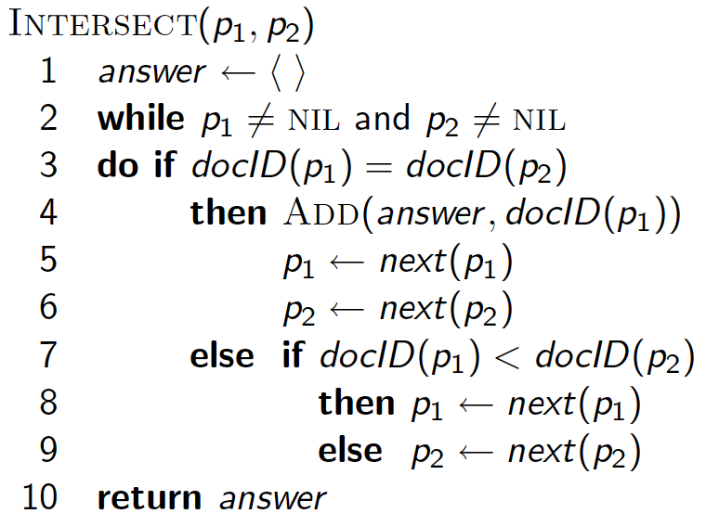
Intersecting two postings lists (a “merge” algorithm)
1/11/2019 SS ZG537 (INFORMATION RETRIEVAL) 36
Pilani Campus

Slide 37
Intersecting two postings lists (a “merge” algorithm)
P1: pointer to current location in list1
P2: pointer to current location in list2
p1
2
2
4
4
8
8
16
16
32
64
128
32
64
128
Brutus
2
1
Caesar
1
2
2
3
5
5
8
8
13
13
21
21
34
3
34
Answer
p2
p2
1/11/2019 SS ZG537 (INFORMATION RETRIEVAL) 37
Pilani Campus

Slide 38
Intersecting two postings lists (a “merge” algorithm)
P1: pointer to current location in list1
P2: pointer to current location in list2
p1
2
2
4
4
8
8
16
16
32
64
128
32
64
128
Brutus
2
1
Caesar
1
2
2
3
5
5
8
8
13
13
21
21
34
3
34
Answer
p2
1/11/2019 SS ZG537 (INFORMATION RETRIEVAL) 38
Pilani Campus

Slide 39
Intersecting two postings lists (a “merge” algorithm)
P1: pointer to current location in list1
P2: pointer to current location in list2
p1
2
2
4
4
8
8
16
16
32
64
128
32
64
128
Brutus
2
1
Caesar
1
2
2
3
5
5
8
8
13
13
21
21
34
3
34
Answer
p2
1/11/2019 SS ZG537 (INFORMATION RETRIEVAL) 39
Pilani Campus

Slide 40
Intersecting two postings lists (a “merge” algorithm)
P1: pointer to current location in list1
P2: pointer to current location in list2
p1
2
2
4
4
8
8
16
16
32
64
128
32
64
128
Brutus
2
1
Caesar
1
2
2
3
5
5
8
8
13
13
21
21
34
3
34
Answer
p2
1/11/2019 SS ZG537 (INFORMATION RETRIEVAL) 40
Pilani Campus

Slide 41
Intersecting two postings lists (a “merge” algorithm)
P1: pointer to current location in list1
P2: pointer to current location in list2
p1
2
2
4
4
8
8
16
16
32
64
128
32
64
128
Brutus
2
8
1
Caesar
1
2
2
3
5
5
8
8
13
13
21
21
34
3
34
Answer
p2
Postings sorted by DocIds.
1/11/2019 SS ZG537 (INFORMATION RETRIEVAL) 41
Pilani Campus

Slide 42
More query processing
Brutus OR Caesar
NOT Brutus
Brutus AND NOT Caesar
Brutus OR NOT Caesar
1/11/2019 SS ZG537 (INFORMATION RETRIEVAL) 42
Pilani Campus

Slide 43
More query processing
Brutus OR Caesar
2
2
4
4
8
8
16
16
32
64
128
32
64
128
Brutus
1
Caesar
1
2
2
3
5
5
8
8
13
13
21
21
34
3
34
1
2
3
4
5
8
13
16
32
21
34
64
128
1/11/2019 SS ZG537 (INFORMATION RETRIEVAL) 43
Pilani Campus

Slide 44
More query processing
NOT Brutus
2
2
4
4
8
8
16
16
32
64
128
32
64
128
Brutus
1
3
5
6
7
9
…
1/11/2019 SS ZG537 (INFORMATION RETRIEVAL) 44
Pilani Campus

Slide 45





Inverted index construction
Documents to
be indexed
Friends, Romans, countrymen.
Tokenizer
Token stream
Friends
Romans
Countrymen
Linguistic modules
DE pluralization
Case folding
friend
roman
countryman
Modified tokens
Indexer
friend
2
4
roman
1
2
Inverted index
countryman
13
16
1/11/2019 SS ZG537 (INFORMATION RETRIEVAL) 45
Pilani Campus

Slide 46
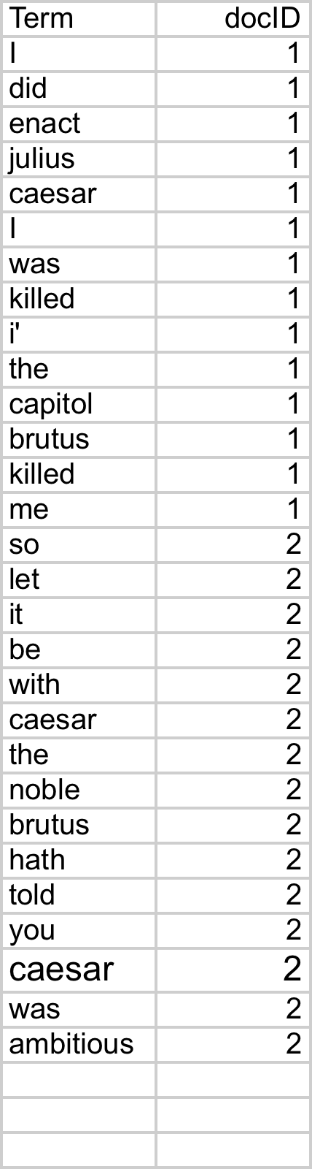
Indexer steps: Token sequence
Sequence of (Modified token, Document ID) pairs.
Doc 1
Doc 2
I did enact Julius
Caesar I was killed
i' the Capitol;
Brutus killed me.
So let it be with
Caesar. The noble
Brutus hath told you
Caesar was ambitious
1/11/2019 SS ZG537 (INFORMATION RETRIEVAL) 46
Pilani Campus

Slide 47
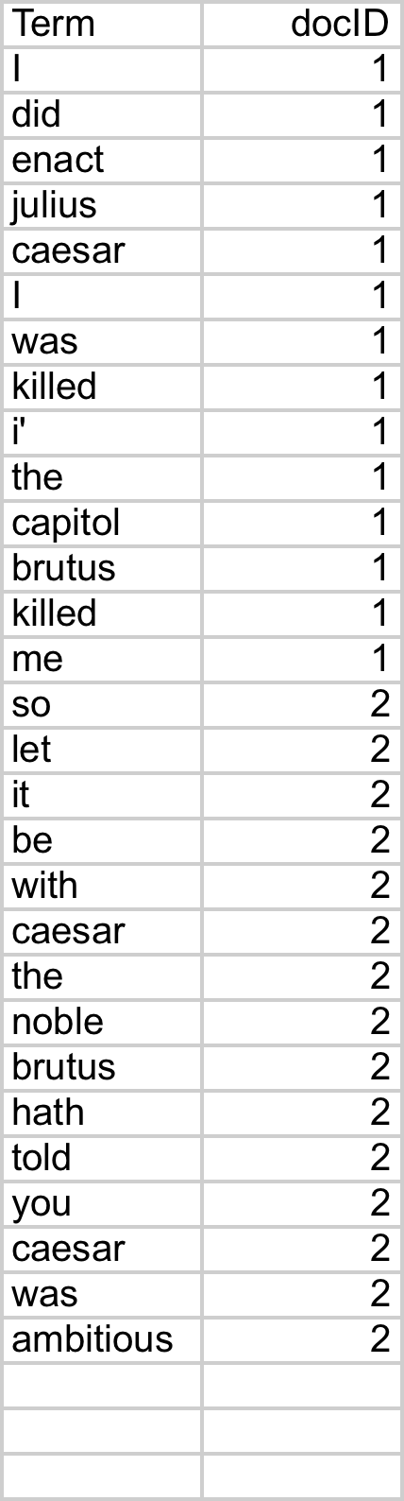
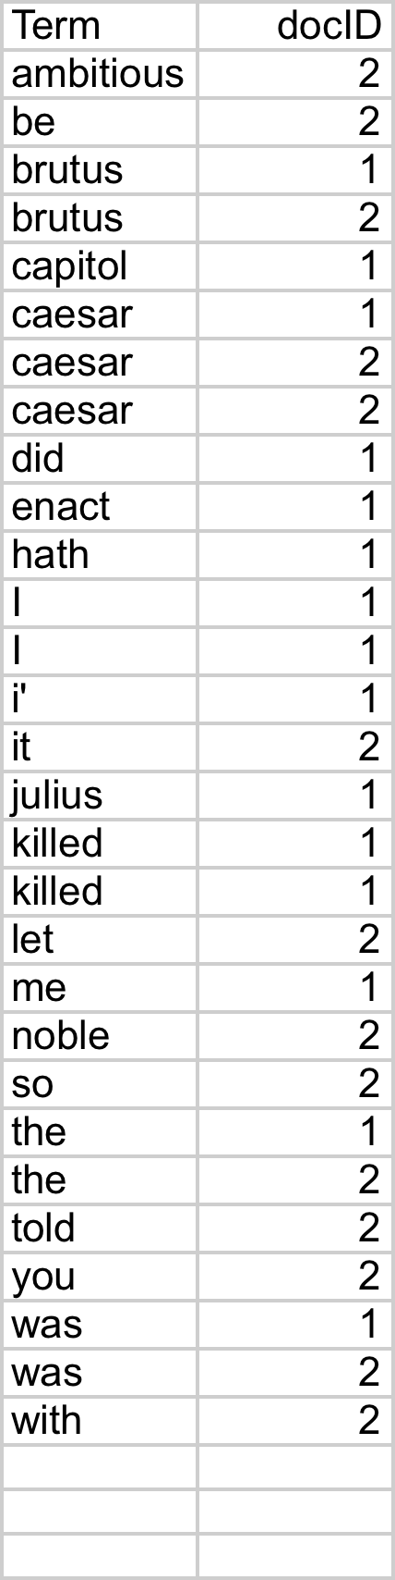
Indexer steps: Sort
Sort by terms
And then docID
Core indexing step
1/11/2019 SS ZG537 (INFORMATION RETRIEVAL) 47
Pilani Campus

Slide 48
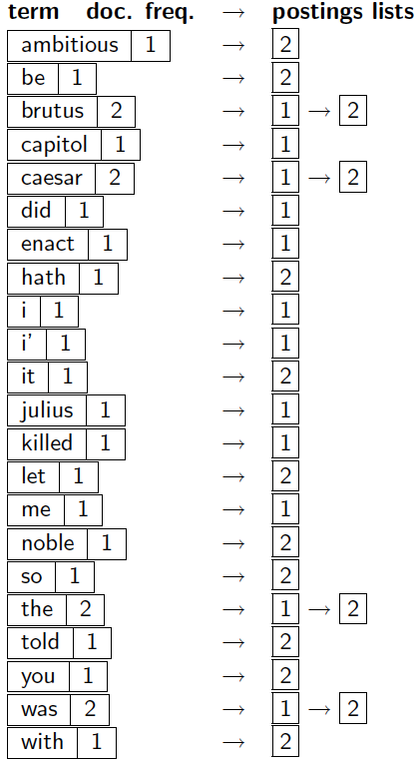
Indexer steps: Dictionary & Postings
Multiple term entries in a single document are merged.
Split into Dictionary and Postings
Doc. frequency information is added.
Why frequency?
Will discuss later.
1/11/2019 SS ZG537 (INFORMATION RETRIEVAL) 48
Pilani Campus

Slide 49
Where do we pay in storage?
Lists of docIDs
Terms and counts
Pointers
1/11/2019 SS ZG537 (INFORMATION RETRIEVAL) 49
Pilani Campus

Slide 50
Query Optimization
Consider a query that is an and of t terms.
For each t terms get the postings list, then AND them together.
Brutus
1
2
4
11
31
45
173
174
Caesar
1
2
4
5
6
16
57
132
Calpurnia
2
31
54
101
QUERY: Brutus AND Caesar AND Calpurnia
1/11/2019 SS ZG537 (INFORMATION RETRIEVAL) 50
Pilani Campus

Slide 51
Query Optimization
Process in the order of increasing document frequency.
Intersect the two postings list
All intermediate results will be no bigger than the smallest postings list, so we are likely to minimize the work.
Brutus
1
2
4
11
31
45
173
174
Caesar
1
2
4
5
6
16
57
132
Calpurnia
2
31
54
101
QUERY: Brutus AND Caesar AND Calpurnia
This is why the doc
freq is stored
Execute the query as (Caesar AND Brutus) AND Calpurnia
1/11/2019 SS ZG537 (INFORMATION RETRIEVAL) 51
Pilani Campus

Slide 52
Boolean Retrieval model
The Boolean Retrieval model can answer any query that is a Boolean expression.
Boolean Queries are queries using AND,OR and NOT to join query terms.
Views each document as a set of terms.
Is precise: document matches condition or not.
Primary commercial retrieval tools for 3 decades.
Many professional searchers (e.g., lawyers ) still like Boolean queries:
You know exactly what you’re getting.
1/11/2019 SS ZG537 (INFORMATION RETRIEVAL) 52
Pilani Campus

Slide 53
Example of a Boolean Retrieval Model
Commercially successful Boolean retrieval : WEST LAW
www.westlaw.com/
Largest commercial legal search service in terms of number of paying subscribers.
Over half a million subscribers performing millions of searches a day over tens of terabytes of text data.
The service was started in 1975.
Boolean search (called ‘Terms and connectors’ by Westlaw) still the default, and used by large percent of users..
1/11/2019 SS ZG537 (INFORMATION RETRIEVAL) 53
Pilani Campus

Slide 54
Westlaw Example Queries
Information need: Information on the legal theories involved in preventing the disclosure of trade secrets by employees formerly employed by a competing company
“trade secret” /s disclos! /s prevent /s employe!
Information need: Requirements for disabled people to
be able to access a workplace
disab! /p access! /s work-site work-place
(employment /3 place)
Information need:Cases about a host’s responsibilityfor drunk guests
host! /p (responsib! liab!) /p (intoxicat! drunk!) /pguest
1/11/2019 SS ZG537 (INFORMATION RETRIEVAL) 54
Pilani Campus

Slide 55
Westlaw Example Queries (2)
/s = within same sentence
/p = within same paragraph
/n= within n words
Space is disjunction, not conjunction (This was the default in search pre-Google.)
! is a trailing wildcard query
1/11/2019 SS ZG537 (INFORMATION RETRIEVAL) 55
Pilani Campus

Slide 56
Limitations of Boolean Retrieval Model
Not tolerant to spelling mistakes
Phrase search(“Stanford University”) and proximity search (Gates /s Microsoft) requires the index to be augmented.
More weight should be given to documents containing higher number of instances of terms?
No ranking of returned results.
1/11/2019 SS ZG537 (INFORMATION RETRIEVAL) 56
Pilani Campus

Slide 57
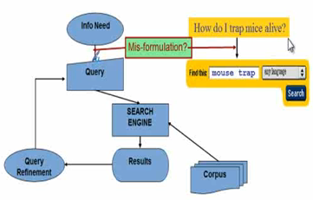
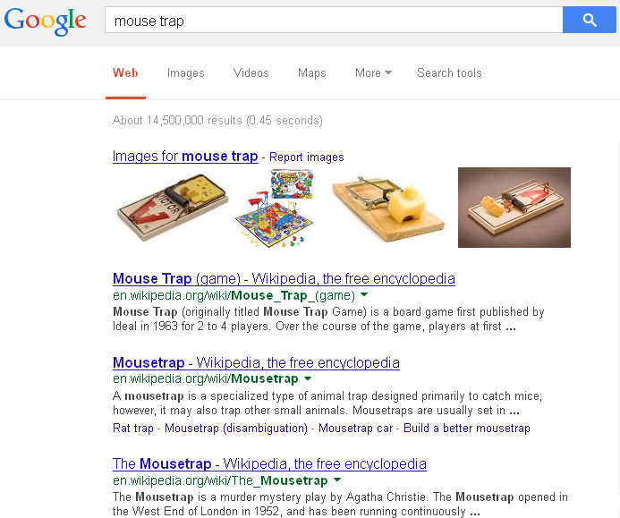
How an User Interact with IR System?
1/11/2019 SS ZG537 (INFORMATION RETRIEVAL) 57
Pilani Campus

Slide 58
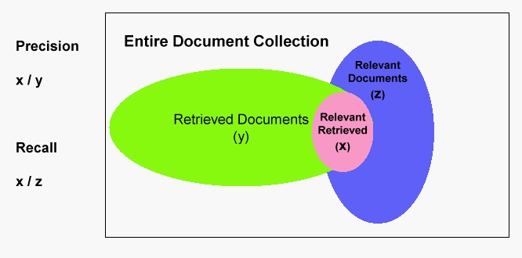
How to evaluate performance of an IR System ?
Precision: Fraction of documents that are relevant to user’s information.
Recall: Fraction of relevant documents in collection that are retrieved.
1/11/2019 SS ZG537 (INFORMATION RETRIEVAL) 58
Pilani Campus

Slide 59
Summary
Course related stuff.
IR is the current trend in research due to unstructured data Tsunami.
A simple IR example for Shakespeare’s written plays.
In an IR system a Term incidence matrix is built apriori and queries are answered using Boolean Retrieval Model.
The problem with Term incidence matrix is that it is sparse and hence the inverted index is built.
1/11/2019 SS ZG537 (INFORMATION RETRIEVAL) 59
Pilani Campus

Slide 60
Summary
The Boolean retrieval model can answer any query that is a Boolean expression.
Boolean queries are queries that use AND , OR and NOT to join query terms.
Views each document as a set of terms.
Is precise: Document matches condition or not.
Primary commercial retrieval tool for 3 decades
Many professional searchers (e.g., lawyers) still like Boolean queries
You know exactly what you are getting.
When are Boolean queries the best way of searching?
Depends on: information need, searcher, document
collection, . . .
1/11/2019 SS ZG537 (INFORMATION RETRIEVAL) 60
Pilani Campus

